Slide 1
Xilinx PYNQ z1 Overlay Creation and Jupyter Notebook Interface for cb4cled
Abishek Bupathi

Slide 2
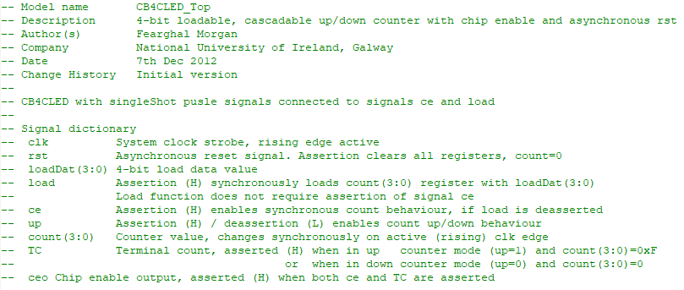
CB4CLED Counter signal dictionary

Slide 3
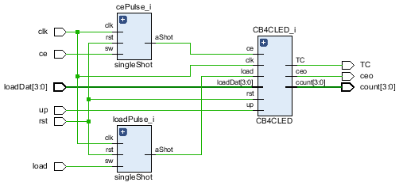
Cb4cled elaborated schematics

Slide 4
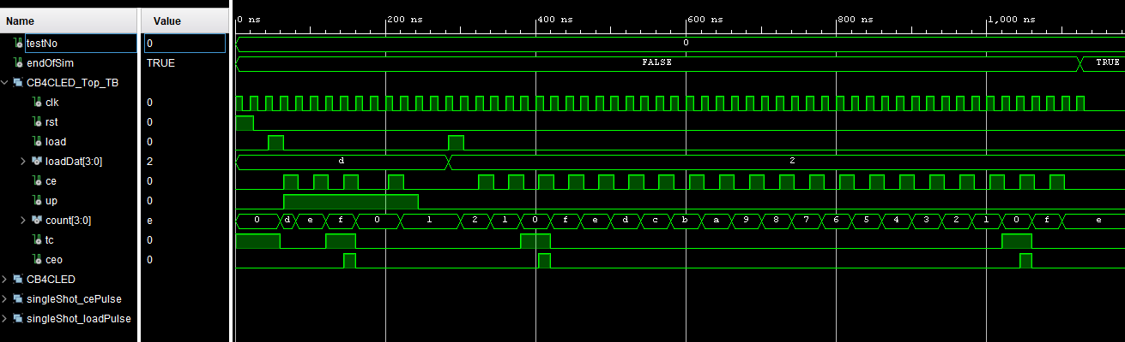
Cb4cled testbench simulation

Slide 5
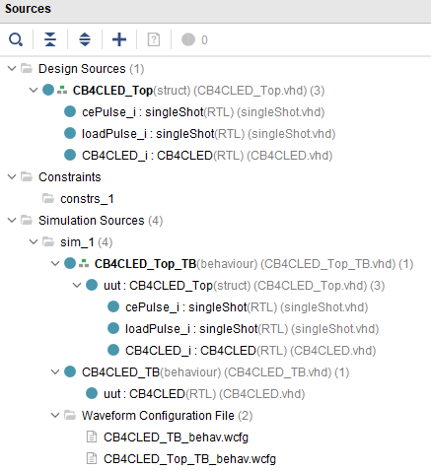
Cb4cled Vivado project structure

Slide 6
Intro
Assume knowledge of
Installation of Vivado 2019.1
Creation of Vivado 2019.1 project
Creation of CB4CLED.vhd vhdl model, testbench
FPGA technology xc7z020 / Package 400-1
When adding VHDL design sources in Vivado, do not select “Copy sources into project”
Simulation / timing diagram analysis; set CB4CLED_TB.vhd as top level in ‘simulation sources’
VHDL synthesis; set CB4CLED.vhd as top level in ‘design sources’
New steps
Application of hardware pin constraints and generate FPGA configuration bitstream file
XDC - Xilinx design constraints, based on TCL scripting language, contains timing and physical constraints
Local FPGA (PYNQ-Z1) prototype/test

Slide 7
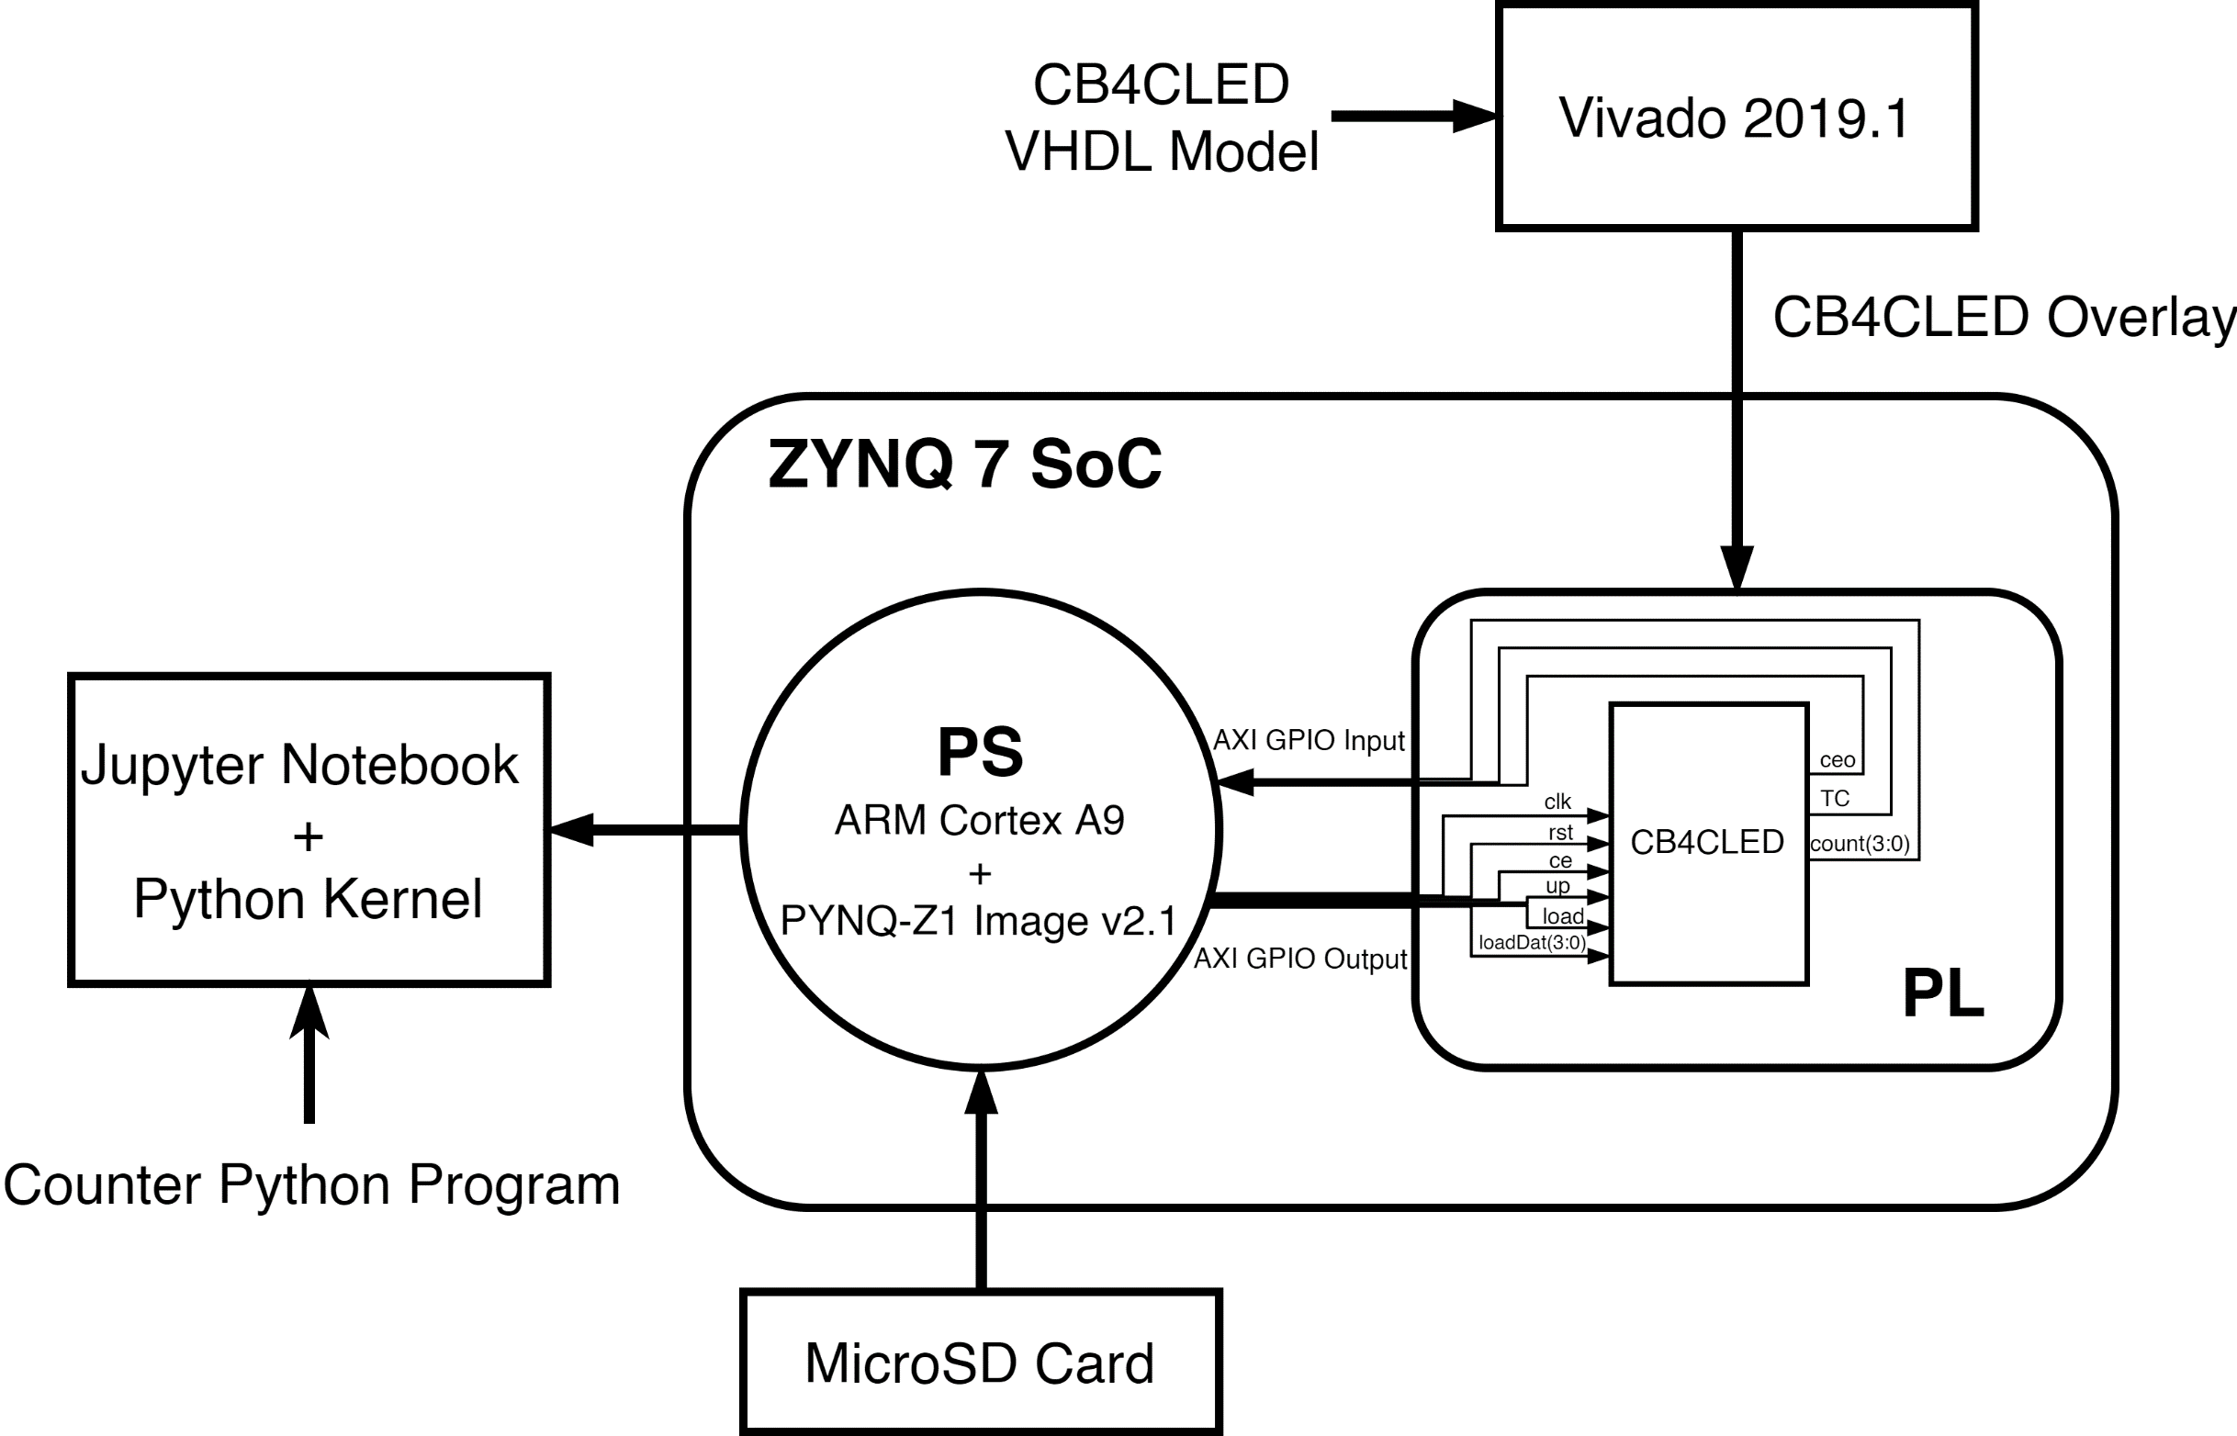
Overview of the system

Slide 8
Creating overlay – project settings for pynq-z1
Download and add PYNQ-Z1 board file to the C:\Xilinx\Vivado\2019.1\data\boards\board_files directory - Board Files — Python productivity for Zynq (Pynq) v1.0
Set the Project device to PYNQ-Z1 in Tools > Settings > General
Download and add PYNQ-Z1 constraint (physical_constr.xdc) file to the project - Constraint file — Python productivity for Zynq (Pynq) v1.0

Slide 9
Creating overlay – block design
Create new Block Design and add ZYNQ7 Processing System IP
Add the CB4CLED Module to the Block Design
Connect the I/O of CB4CLED to PS using AXI GPIO and AXI Interconnect IP
Add System reset IP and connect clk and rst signals using connection automation

Slide 10
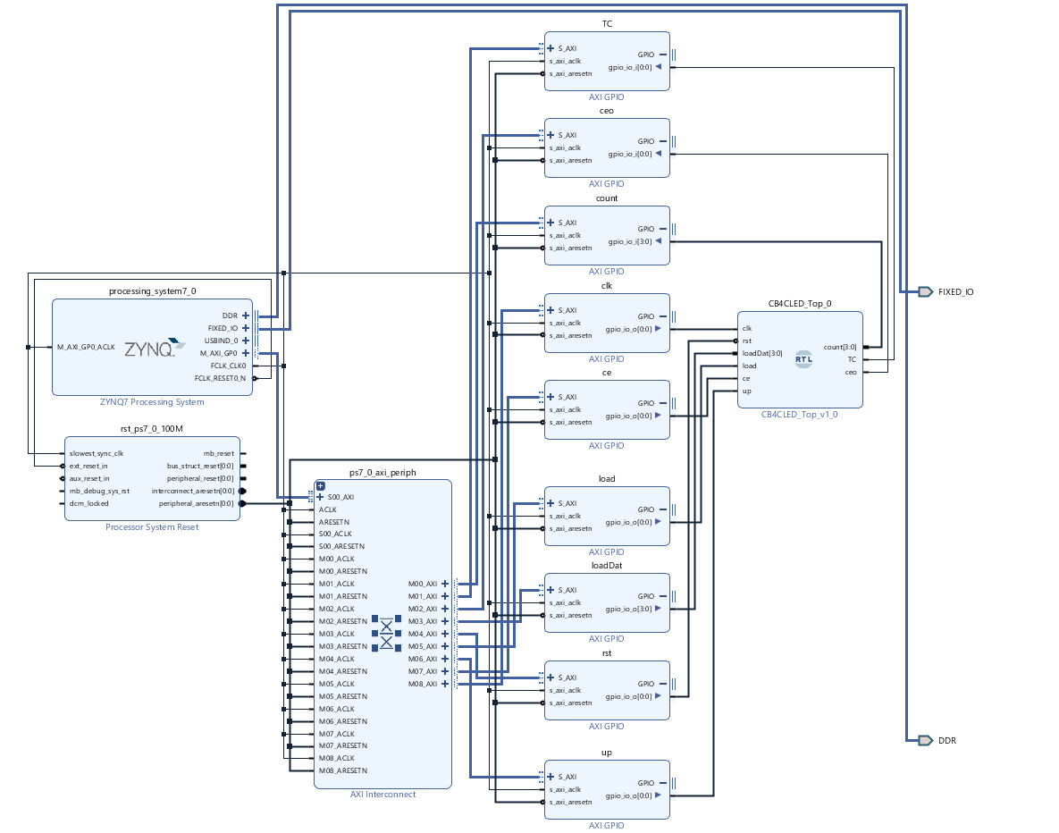
Completed Block Design

Slide 11
Creating overlay – Generating Overlay files
Auto-assign address to the I/O of CB4CLED from the Address Editor menu
Create HDL Wrapper for the Block Design
Set HDL Wrapper as Top
Generate Bitstream
Export Block Design

Slide 12
Overview of PYNQ-Z1 Setup and Accessing Jupyter Notebook
Load PYNQ-Z1 Image onto the microSD and connect to Computer via microUSB and Ethernet cable
Set static IP for the Ethernet on the Computer (Only when PYNQ board is directly connected to computer via Ethernet Port)
Access Linux terminal of PYNQ-Z1 using ComPort Serial or ssh
Access Jupyter Notebook through browser
Python program for CB4CLED control using Overlay API

Slide 13
Getting started with Pynq-z1
Flash a 8GB or more microSD card with PYNQ-Z1 Image v2.1 that can be obtained from the pynq.io documentation: PYNQ image — Python productivity for Zynq (Pynq) v1.0
Win32 Disk Imager, Rufus or Balena Etcher can be used for writing the Image to SD card.
Insert the microSD card into the card slot at the back of PYNQ-Z1 board [3]
Connect to the computer via microUSB [4]
Connect one end of Ethernet cable to the Ethernet port on the board and other end either to a router or Ethernet port on the Computer [5]

Slide 14
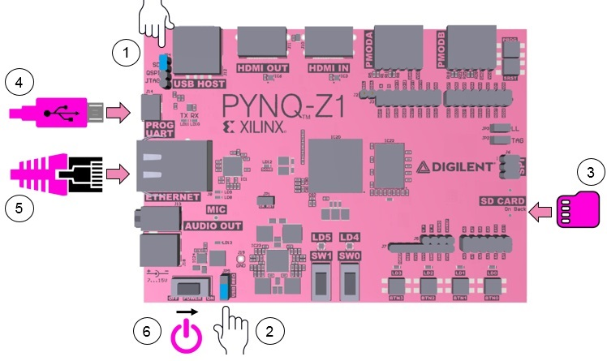
Change the Jumper JP4 to connect SD pins on the board [1]
Connect USB pin using another Jumper on JP5 port to get power supply from USB [2]
After completing all the connections, the board can be turned on using the Power switch [6]
Red LED near power switch will light up indicating power supply
Green LED (LED2) will turn on as the board starts to boot
4 Green LEDs near switch and 2 Blue LEDs with flash when
the board becomes operational

Slide 15
assign static Ip on Computer
On Windows:
Go to Control Panel -> Network and Internet -> Network Connections
Find your Ethernet network interface, usually Local Area Connection
Double click on the network interface to open it, and click on Properties
Select Internet Protocol Version 4 (TCP/IPv4) and click Properties
Select Use the following IP address
Set the IP address to 192.168.2.1 (or any other address in the same range as the board)
Set the subnet mask to 255.255.255.0 and click OK
For Mac OS and Linux please follow the steps in the PYNQ Documentations: Assign a static IP address — Python productivity for Zynq (Pynq)

Slide 16
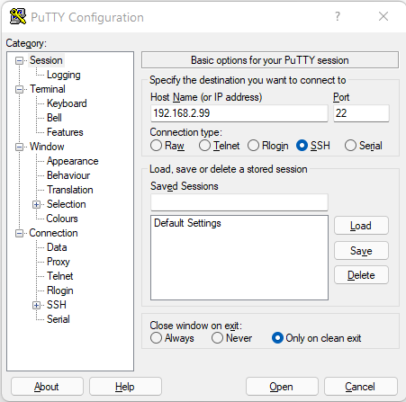
pynq-z1 Linux Terminal
Method 1: Using ssh
Install PuTTY, a free ssh client - Download PuTTY - a free SSH and telnet client for Windows
Select Connection type to ssh
Give the Host Name address to 192.168.2.99 (IP Address of PYNQ-Z1)
Set port to 22
Click on Open
Username: xilinx password: xilinx

Slide 17
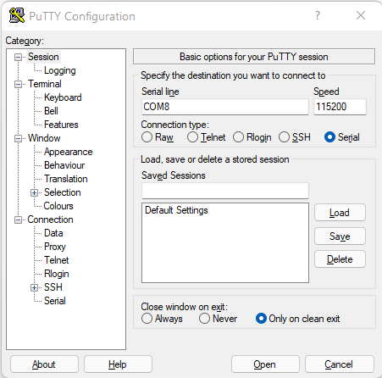
pynq-z1 Linux Terminal
Method 2: Using ComPort
Open Device Manager and find the Port for USB Serial Port
Open PuTTY and select Serial
Enter Serial line to the ComPort of the PYNQ-Z1
Set Speed to 115200
Click on Open
Username: xilinx password: xilinx

Slide 18
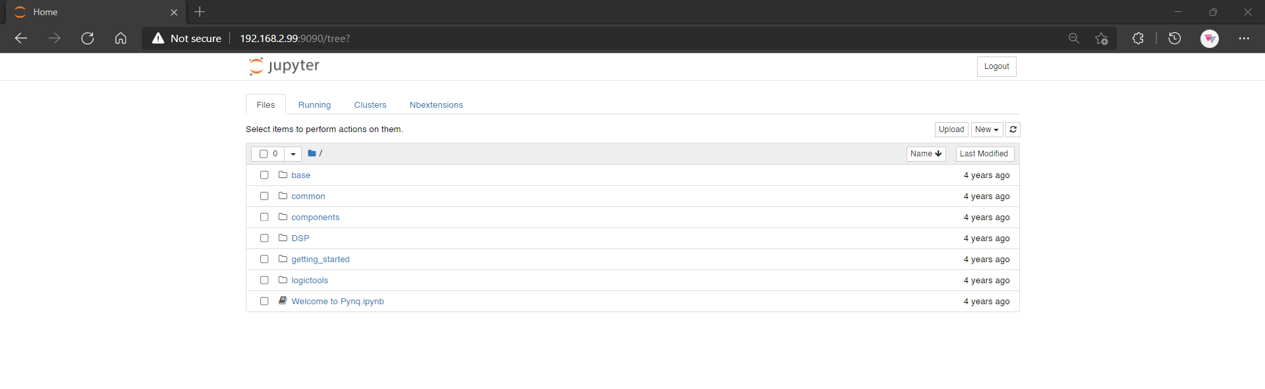
Access Jupyter notebook
If the PYNQ-Z1 is connected directly to Computer then browse to http//192.168.2.99:9090 in the Computer Browser
When connected to Network Router then go to http://pynq:9090 in the browser

Slide 19
Importing Overlay files
Overlay File Locations
.bit – cb4cled.runs\impl_1
.hwh – cb4cled.srcs\sources_1\bd\design_1\hw_handoff
.tcl – Project directory
Create new directory in Jupyter Notebook
Upload the Overlay files into the newly created directory

Slide 20
Using the python overlay APi
Create new Python Notebook
Import Overlay class from pynq Library
from pynq import Overlay
Instantiate the CB4CLED Overlay by specifying the bitstream file name and creating an overlay object
counter = Overlay(“cb4cled_design.bit")

Slide 21

Overlay api: read and write signals
Check the available signals of the counter using
counter.ip_dict.keys()
Writing data to the signals
Example: ce.write(0, 1) # write(offset, value)
Reading data from the signals
Example: count_value = count.read()

Slide 22
Python program for cb4cled
Setting default values and Reset
load.write(0, 0)
ce.write(0, 0)
up.write(0, 1) # Setting up signal to high
rst.write(0, 1) # Asserting reset
clk.write(0, 1) # Rising clock edge
clk.write(0, 0) # Falling clock edge
rst.write(0, 0) # Setting reset signal back to 0
clk.write(0, 1)
clk.write(0, 0)

Slide 23
Python program for cb4cled
Loading data onto Counter and setting up count
# Load Data
loadDat.write(0, int('4', 16)) # Loading value 4 onto counter
load.write(0, 1) # Asserting load signal
clk.write(0, 1) # Rising clock edge
clk.write(0, 0) # Falling clock edge
load.write(0, 0) # Setting load signal to low
# Set up counter
up.write(0, 1) # Setting up signal to high
clk.write(0, 1) # Rising clock edge
clk.write(0, 0) # Falling clock edge
print("Loaded value: ", count.read()) # Reading count signal

Slide 24
Python program for cb4cled
Activating the Counter and reading output
clk.write(0, 0)
clk.write(0, 1)
ce.write(0, 1) # Asserting Chip Enable
print("ceo: ", ceo.read()) # Reading ceo signal
clk.write(0, 0)
clk.write(0, 1)
ce.write(0, 0) # Setting chip enable to low
clk.write(0, 1)
clk.write(0, 0)
print("TC: ", TC.read()) # Reading TC signal
print("Count: ", count.read()) # Reading count value
clk.write(0, 0)

